Slide 1
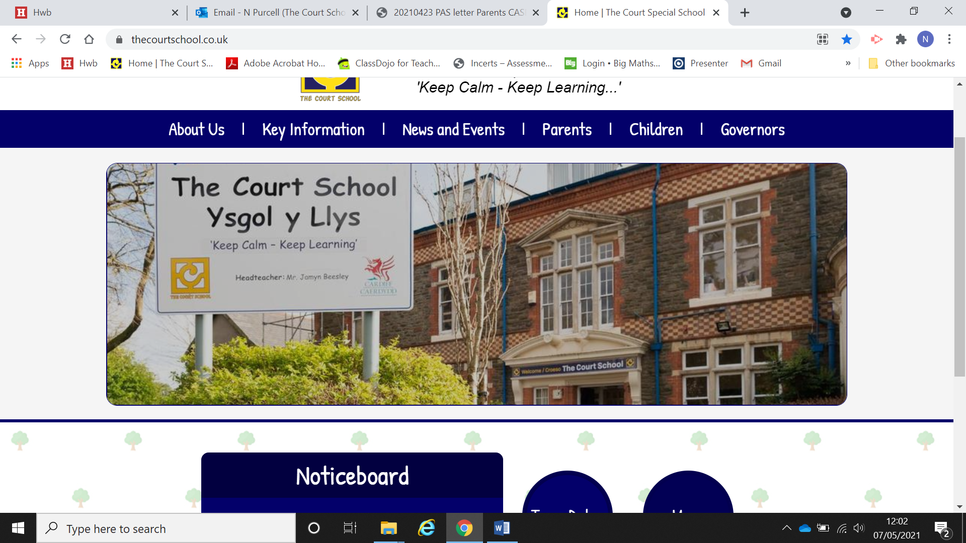
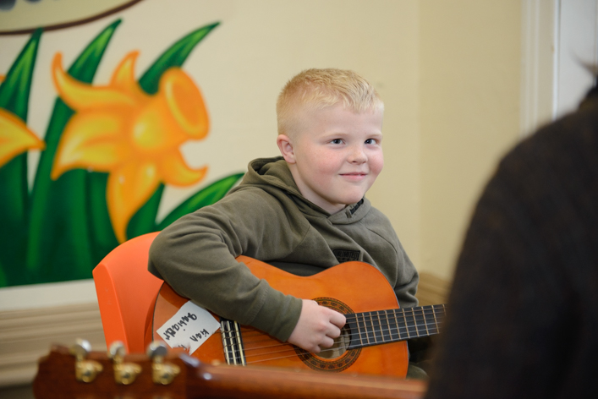
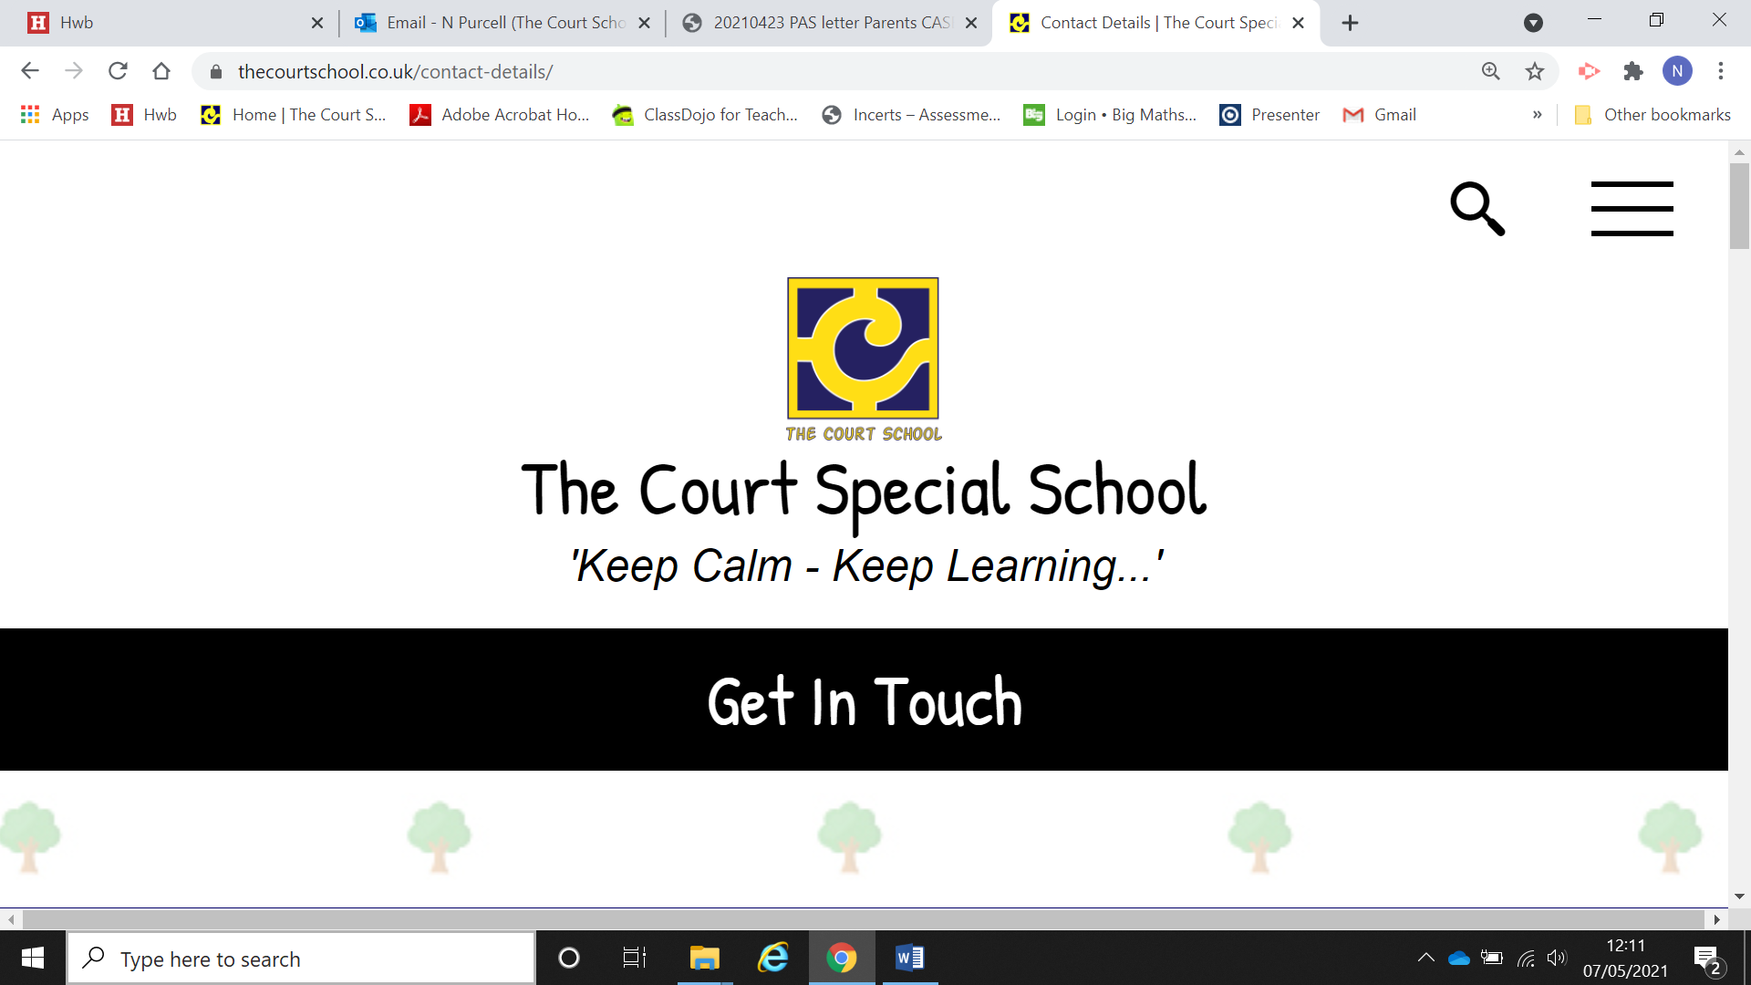
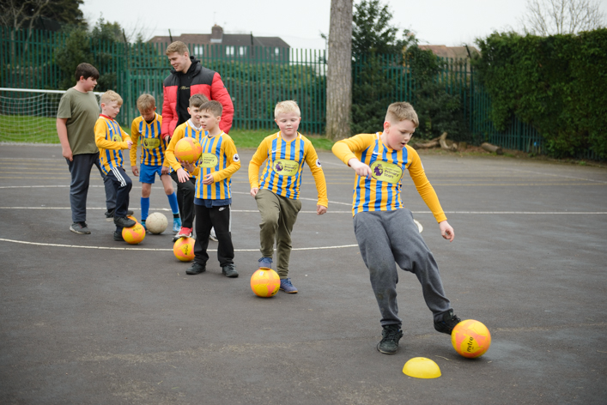
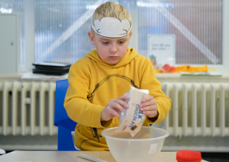
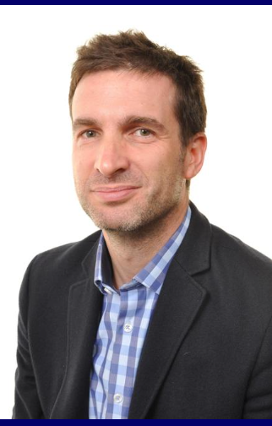
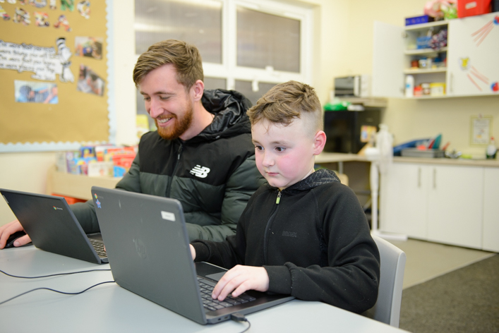
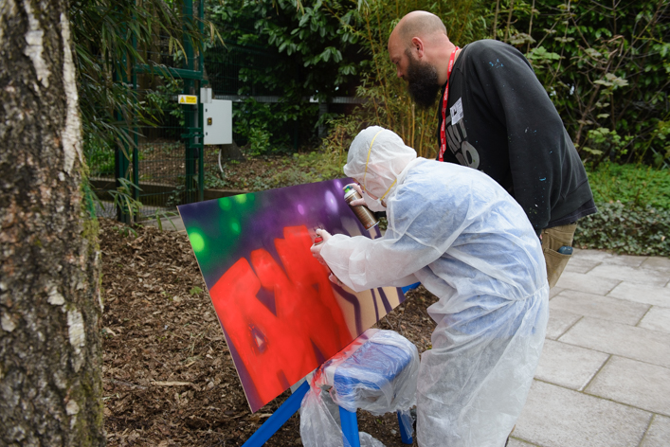
The Court School
Prospectus 2023-2024
Jamyn Beesley
Headteacher
Tel. 07495158404
Ross Fitzpatrick - Deputy Head. 07458073270
Caroline Joy - Deputy Head. 07458079269
Neil Purcell - Transition Support. 07458079250
The Court School
96a Station Road
Llanishen
Cardiff
CF14 5UX
Phone: (029) 20752713
www.thecourtschool.co.uk
Twitter/X : @courtschool
School Day
9:10am to 3:10pm
Email: thecourtsp@cardiff.gov.uk

Slide 2
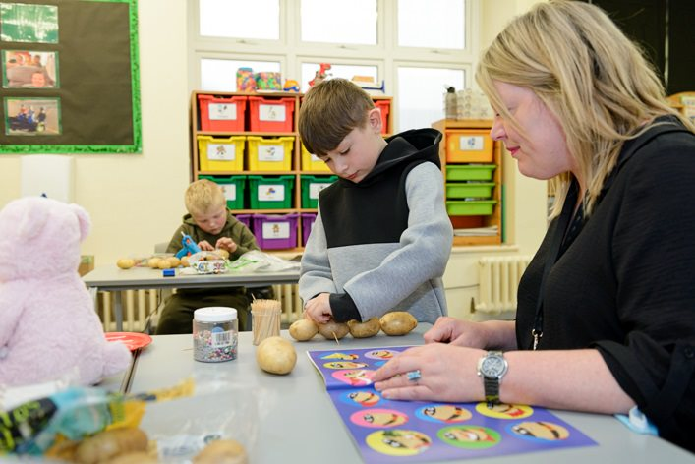
Keep calm – Keep learning
Here at the Court School everybody is committed to making school a really positive experience for you and your child. Our experienced staff provide a safe, caring environment which will encourage your child to reach their potential and be able to feel proud of themselves.
The Court School offers a highly nurturing environment for 42 pupils who experience difficulties with social communication and emotional regulation. When our learners present with challenging behaviours they are always met with trauma informed, non-judgemental approaches. All our pupils are treated as individuals.
Intro
Values
Uniform
Transport
Our core values underpin everything we do here at The Court School.
Keep everyone safe
Communicate effectively
Stay positive
Be flexible
Respect our differences
Maintain high expectations

Slide 3
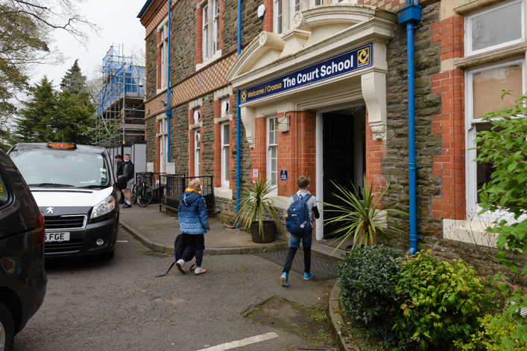
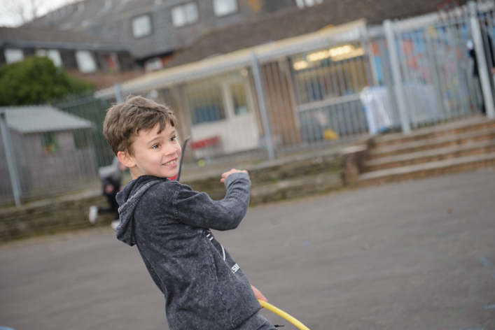
Communication
At the Court School we know how important our relationship with parents and carers is. We work hard to make sure that you feel included in your child’s care and education. Staff in your child’s class will contact you regularly to let you know how they’re getting on.
Please feel free to contact them via text, WhatsApp or a phone call with any concerns or information you wish to share. Staff will always remain supportive and non-judgemental.
Intro
Values
Uniform
Transport
Uniform
We understand that for some learners school uniform is very uncomfortable. The only uniform we encourage our learners to wear is a navy jumper or hoodie with our logo.
All learners receive two items of school uniform for free when they join our school. If you need any more jumpers or hoodies these are available to buy from the school office.
Transport
Pupils at The Court School are entitled to home to school transport. This is organised by the local authority who's number is 029 20872942. Any parent or carer wishing to transport their child to school is entitled to claim back the mileage. Please speak to the school if you wish to do this.

Slide 4
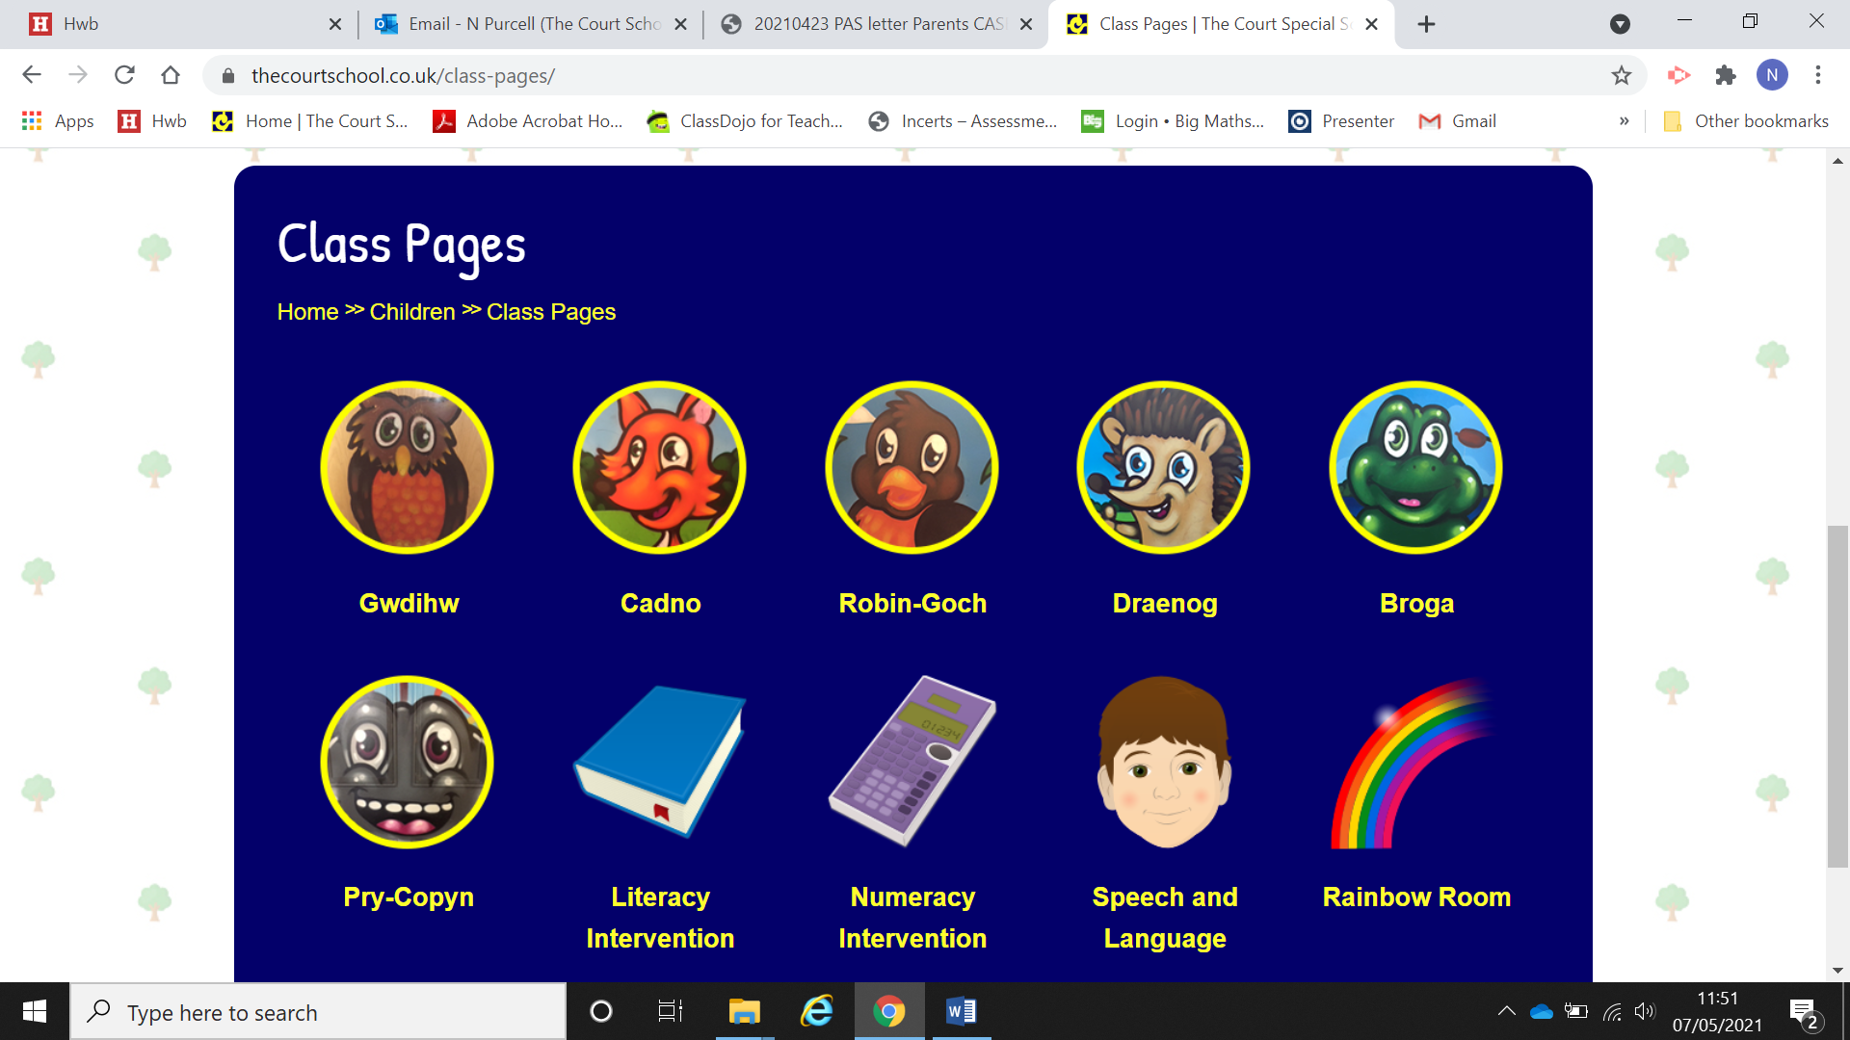
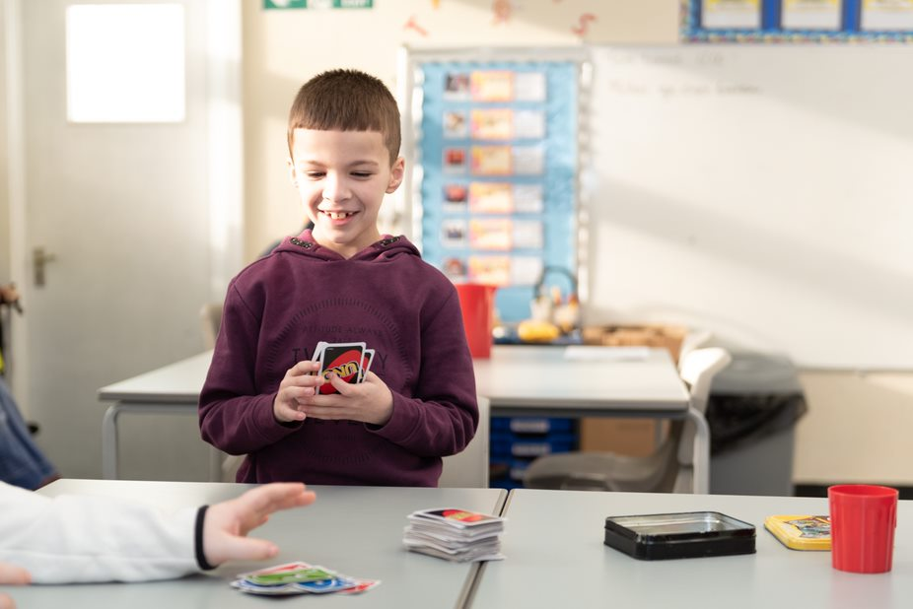
Our Classes
Interventions
Some of our learners can struggle with certain aspects of their learning. Staff will try and target those learners and help them, either inside the classroom or in a quiet space where they can work 1:1.
Dosbarth Broga
Class Teacher: Mr Perkins
Phone: 07458073357
We have 6 classes of 7 pupils in Court School.
Each class has a teacher and 2 learning support assistant with lots more help available if needed.
Classes are not set into strict year groups. We find the right class for the pupils so they may be in a class with older or younger pupils.
Dosbarth Cadno
Class Teacher: Miss Lewis
Phone: 07458073355
Dosbarth Draenog
Class Teacher: Mrs Jenkins
Phone:07458073354
Dosbarth Gwdihŵ
Class Teacher: Mrs McIver
Phone: 07458073358
Curriculum (Core Purpose Charactrs)
Classes (teachers and class phone)
Dosbarth Robin Goch
Class Teacher: Mr Howden
Phone: 07458073356
Our classes are named after woodland creatures in Welsh.
Dosbarth Pry Copyn
Class Teacher: Mrs Fowler
Phone: 07458073353

Slide 5


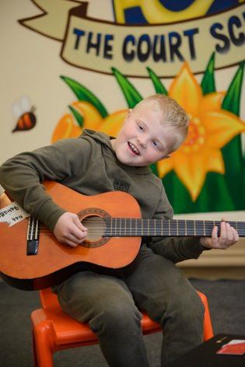

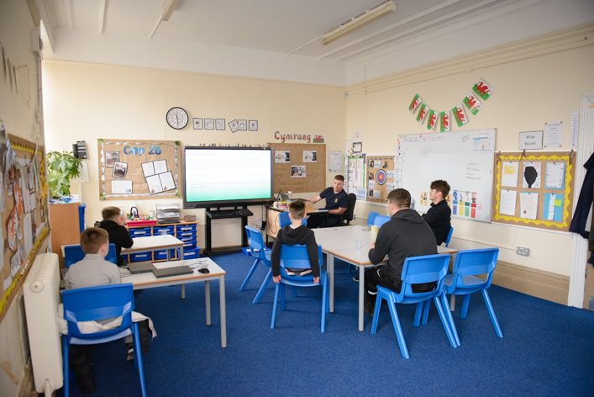
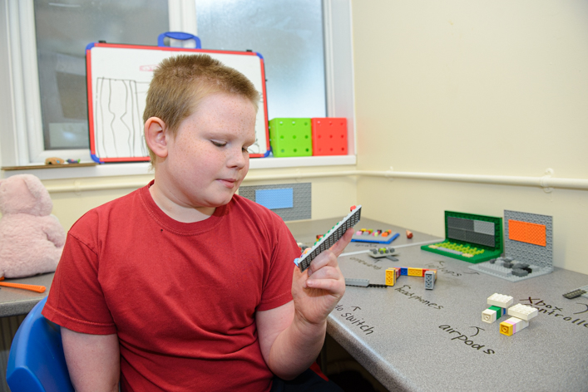

Our Curriculum
The wellbeing of our pupils is our number one priority and we understand that pupils learn best when they are regulated, calm and happy. Therefore; we prioritise relationships, play lots of games and give pupils plenty of 'brain breaks' and 'time out' when they need it.
We believe in 'hands on' practical and experiential learning - this is how many of our pupils learn best! We also organise regular trips out of school to enhance pupils' learning and to give them opportunities to refine their skills.
Our curriculum is very flexible and is continually adapted to meet the needs of pupils/classes. We are continually striving to improve and develop our offering and if we don't feel something is working we change and adapt it so it better meets the needs of learners.
Key literacy and numeracy skills are taught throughout the mornings and pupils then have opportunities to apply these skills throughout the afternoons when the focus is on topic work. The topics chosen for the class, usually for a half term period, are closely matched to the interests of the pupils.

Slide 6
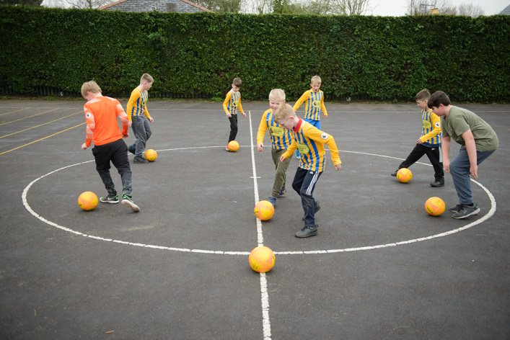
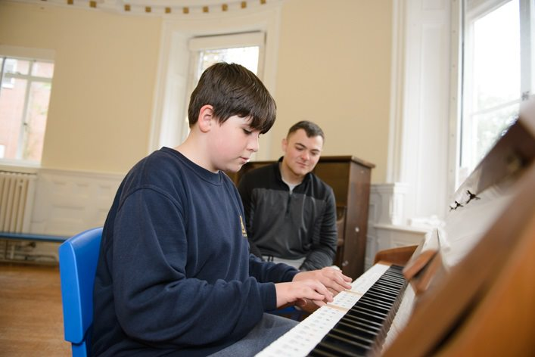

Safeguarding
If you have any concerns about child protection or safeguarding please contact one of our designated child protection officers.
Jamyn Beesley - 07495158404
Ross Fitzpatrick - 07458073270
Caroline Joy- 07458079250
Rhian Hartwell - 07458079251
Alternatively you can contact the governor in charge of safeguarding Emma Powell or the Chair of Governors Garry Hunt via the school office
Support for parents and carers
The Court School staff will always try and support families as much as they can . We can offer advice, signpost to other agencies who might be able to help or just provide a listening ear. Once every half term we hold an informal coffee morning for our parents and carers for a chance to meet other families facing similar challenges.
If there's anything you think we can support with please contact Mrs Hartwell on 07458079251
Psychotherapy
We are very lucky to have a psychotherapist who works at the school. Dr Alyson Richards works closely with our learners and their families. Please speak to the school if you feel that you and your child would benefit from working with Dr Alyson.
School dinners
School dinners can be paid for using ParentPay. Please contact the school office if you need any help. We can also supply the free school meal forms.

